Slide 1
Planning and the enduring legacy of the thinkers behind Garden Communities
Tom Barker

Slide 2
“Optimism is a strategy for making a better future. Because unless you believe that the future can be better, it’s unlikely you will step up and take responsibility for making it so. If you assume that there’s no hope, you guarantee that there will be no hope. If you assume that there is an instinct for freedom, that there are opportunities to change things, then there’s a chance you may contribute to making a better world. The choice is yours.” Noam Chomsky

Slide 3
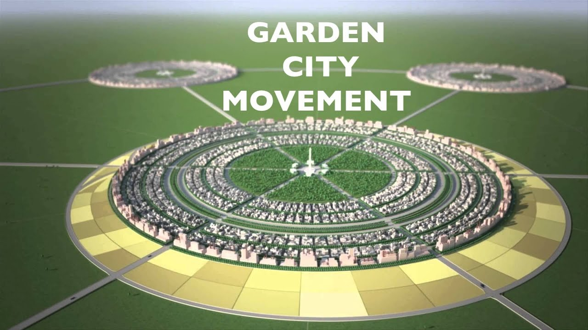

Slide 4
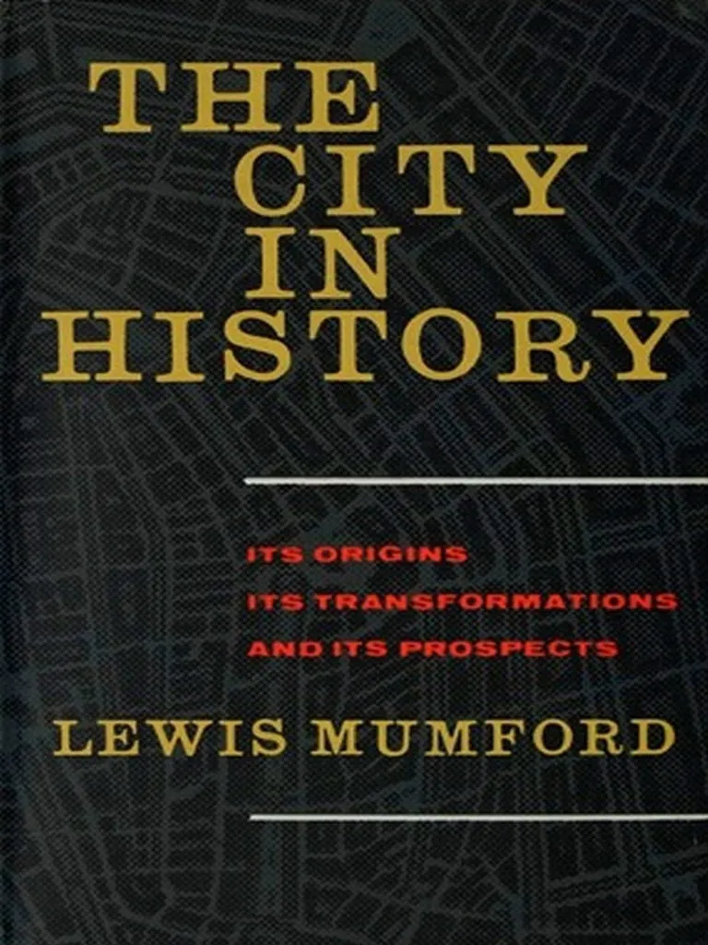

Slide 5
Eutopia “the good place” brought down from the clouds and planted firmly on the ground

Slide 6
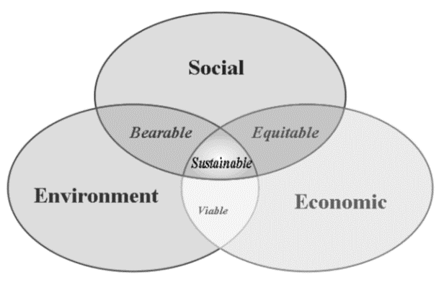

Slide 7
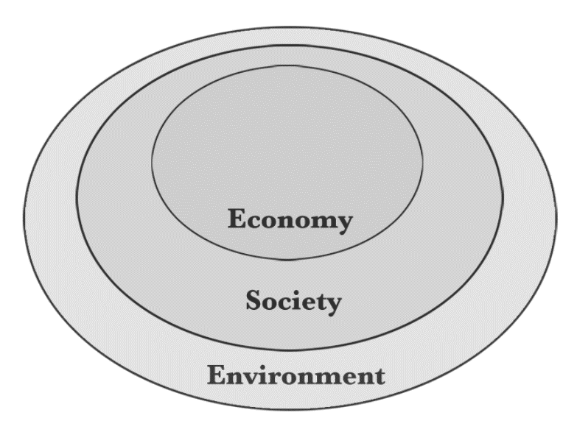

Slide 8
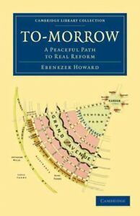

Slide 9
“There is no reason to accept the doctrines crafted to sustain power and privilege, or to believe that we are constrained by mysterious and unknown social laws. These are simply decisions made within institutions that are subject to human will and that must face the test of legitimacy. And if they do not meet the test, they can be replaced by other institutions that are more free and more just, as has happened often in the past.” Noam Chomsky

Slide 10
Contact me: Tom Barker Assistant Director Babergh & Mid Suffolk District Councils tom.barker@baberghmidsuffolk.gov.uk

